Slide 1
NovaCell Churn Radar
NovaCell doesn't lack retention offers. It calls the wrong customers with the wrong one.
Ashokkumar Burasiya · AI Product Manager
8 November 2026 · all data synthetic

Slide 2
After the price rise, churn nearly doubled and the call rule can't see it
9.3%
12%
71%
43%
of customers left within 60 days in the August cohort, up from 5.1% in June
of customers on today's call list actually leave (precision of the rule)
of leavers the rule never flags: 332 of 465
of leavers raised no support ticket, so a ticket rule cannot see them
Customers with the September price-rise notice and a competitor promo nearby left at 18%, against 6% without the price rise. Everyone who threatened to leave got the same 20% discount.
Source: synthetic NovaCell cohorts (5,000 customers each, June and August 2026), generated for this project.
NovaCell Churn Radar · all data synthetic

Slide 3
Discovery: the team only meets customers who have already decided
Priya, Retention Team Lead
"My team only hears from customers once they ask for their transfer code."
Priya (synthetic quote)
Primary persona (synthetic)
• Leads 40 agents and the retention budget
• Builds the call list from two Excel exports every Monday
• Reports saves monthly with no control group
• Goal: save more customers per call and per dollar
"Is this a price problem or a network problem? The fix is completely different."
Priya (synthetic quote)
"I open every call cold. I find out the reason halfway through, if at all."
Retention agent (synthetic quote)
"Show me which offers actually keep customers, or I can't fund them."
Finance partner (synthetic quote)
NovaCell Churn Radar · all data synthetic

Slide 4
Five whys lead to one root cause: no early, explained risk signal
1
2
3
4
5
Churn nearly doubled
Team didn't see it
Rule uses two fields
No risk model
Wrong people, wrong fix
Price rise and competitor promo in August.
The rule misses 71% of leavers.
Usage, network, billing and tickets sit in four systems.
Churn was a save-desk problem, not a prediction one.
Blanket discounts; network and billing problems unfixed.
Root cause
The team cannot see who is likely to leave, or why, until the customer has already decided. One rule and one discount are used for every reason, so money and calls go to the wrong customers with the wrong fix.
NovaCell Churn Radar · all data synthetic

Slide 5
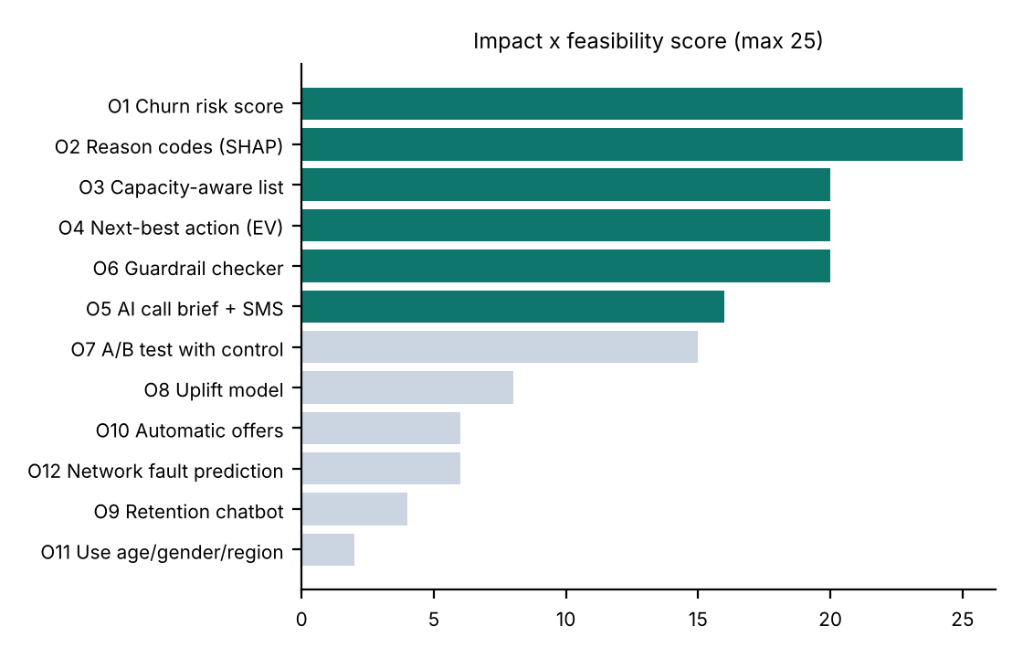
We scored 12 opportunities and built the top six
Built: the six Do-first ideas
Risk score, reasons, capacity-cut list, expected-value offer, checked AI brief and the checker itself.
Parked on purpose
Automatic offers, a customer chatbot and demographic targeting (risk and fairness). The A/B test and uplift model come next: they need the pilot's outcome data.
NovaCell Churn Radar · all data synthetic

Slide 6
Four steps, one rule: ML decides who and why, the AI only writes
1
2
3
4
Score
Explain
Choose
Brief
Logistic regression gives every customer a 60-day churn probability each week.
SHAP turns each score into three plain-language reasons.
Expected value picks one approved offer, or none when nothing pays back.
The LLM writes a call brief and SMS from those facts; code checks it.
The agent decides
Nothing is sent automatically. The agent reads the brief, makes the call and records the outcome. A 10% control group shows which calls and offers really save customers.
NovaCell Churn Radar · all data synthetic

Slide 7
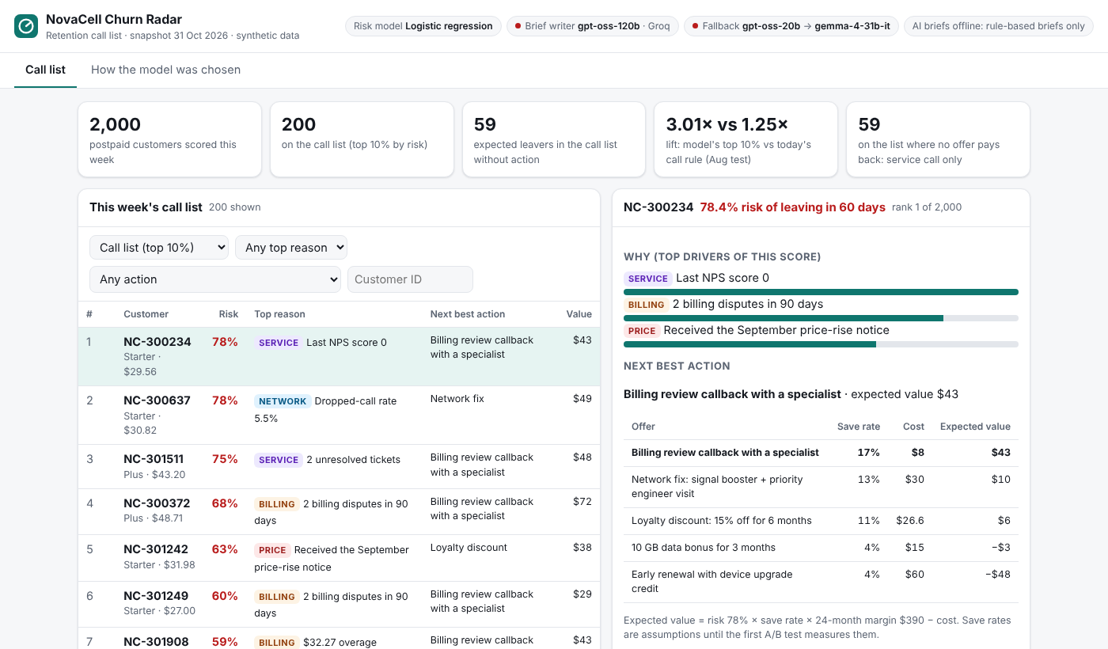
Monday 9 am: Priya's list is sized to her team and every row has a reason
1
Sized to capacity
Top 10%: 200 of 2,000 customers, about 59 expected leavers.
2
A reason on every row
Price, billing, service, network, contract or engagement, with the fact behind it.
3
The offer that pays back
Or none: 59 customers on the list get a service call, not a discount.
4
Brief in one click
Checked before it is shown; nothing is sent.
NovaCell Churn Radar · all data synthetic

Slide 8
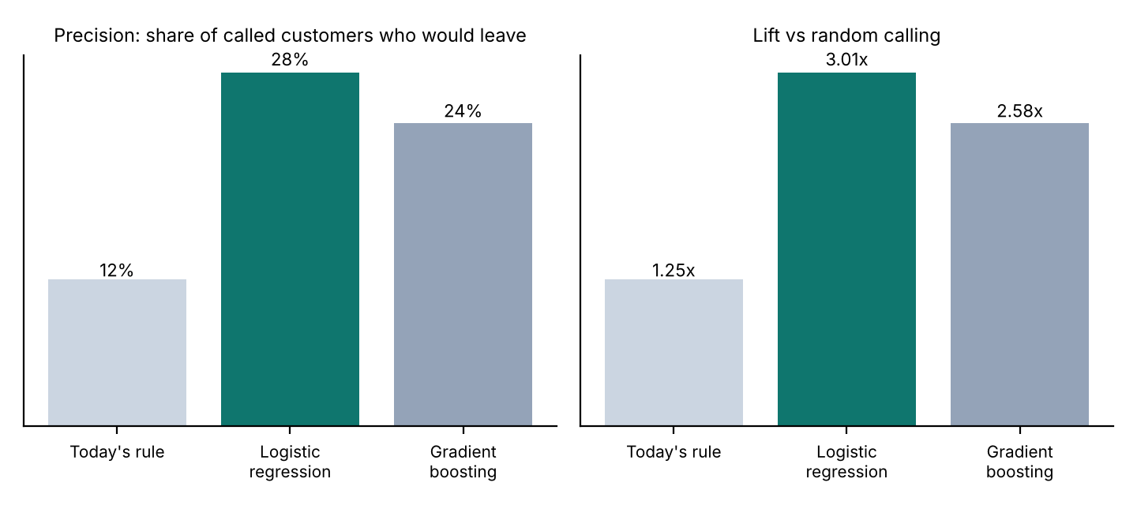
The simpler model held up when the market moved, so we chose it
3.01x vs 1.25x
Trained on June, tested on August: after a price rise the June data had never seen.
Logistic regression: ROC AUC 0.7244, precision 28% in the top 10%.
Gradient boosting: ROC AUC 0.7068, precision 24%.
It also explains exactly. Production is retrained on June + August.
NovaCell Churn Radar · all data synthetic

Slide 9
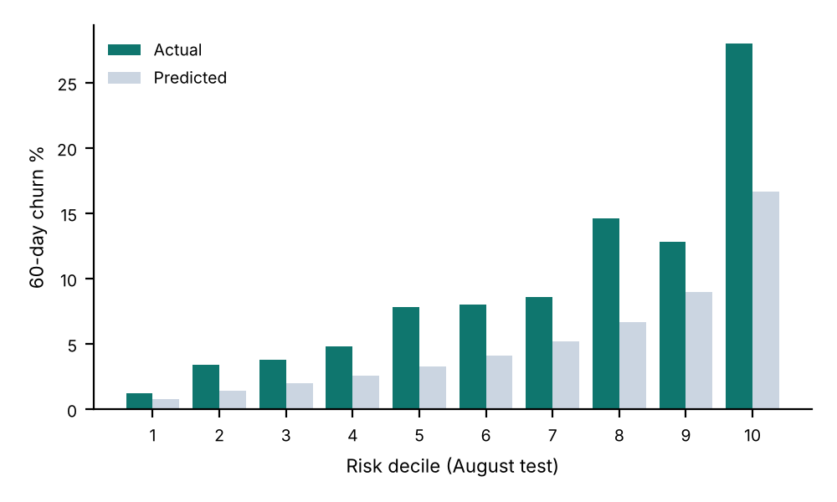
Fair by design, honest about calibration
Group | Flag-rate ratio | p (flagged) | p (caught) | Reading
Age band | 0.774 | 0.3469 | 0.1304 | No significant difference
Gender | 0.972 | 0.78 | 0.6657 | No significant difference
Region | 0.483 | 0.0 | 0.0041 | Differs: weaker network in East and Central
Age, gender and region are never model inputs; they are used only for this test.
Region differs because East and Central have weaker coverage: the model sees dropped calls and slow speeds, and the right fix there is the network-fix offer, not a discount.
The June model under-predicted August churn by about half. The list uses rank, which held up; monthly retraining fixes the level.
NovaCell Churn Radar · all data synthetic

Slide 10
Rules where possible, ML where it ranks better, AI only for words
Weekly snapshot
21 inputs, no personal traits
Data
About $11 a month
Score
Logistic regression, 60-day risk
ML
for 30,000 briefs at Groq list prices, plus about $25 for scoring and hosting. The prototype runs on free tiers.
Explain
SHAP, top 3 reasons
ML
Choose
Expected value across 5 offers
Code
Prototype stack
Write
Brief + SMS from facts only
gpt-oss-120b
Python + scikit-learn + SHAP for the model; Node on Vercel's free tier for the app; Groq gpt-oss-120b, then gpt-oss-20b, then Gemma on OpenRouter.
Check
Numbers, offer, wording, injection
Code
NovaCell Churn Radar · all data synthetic

Slide 11
North Star: customers saved per 1,000 called, against a control group
Layer | Metric | Today → target
AI (model) | Precision in top 10% | 12% (rule) → 25%+ (test 28%)
AI (brief) | Shown briefs passing checks | 100%; AI brief rate 90%+
Product | Calls using the brief; prep time | 80% of calls; under 1 minute
Business | Retention spend per save | -30%
Guardrail | Fairness tests; unapproved offers | p ≥ 0.05 by age and gender; 0
Saves per 1,000 called
Treatment vs a 10% control group, per offer and reason.
Baseline: unknown, there is no control today.
Pilot target: +25 saves per 1,000 called.
It measures the decision we change: who we call and what we offer.
NovaCell Churn Radar · all data synthetic

Slide 12
The AI brief passes its launch evals
Set | Cases | Safe shown | Right offer | AI brief rate | Reason covered | Injection blocked | p95
dev | 30 | 100% | 100% | 100% | 100% | - | 1.8 s
holdout | 20 | 100% | 100% | 100% | 100% | - | 1.6 s
safety | 15 | 100% | 100% | 100% | 100% | 100% | 1.4 s
Safety is measured on what the agent sees: an AI brief that fails a check is never shown; the rule-based brief replaces it. Offline tests also check all 2,000 rule-based briefs and 10 deliberately broken briefs on every build.
NovaCell Churn Radar · all data synthetic

Slide 13
The highest risks, and the guardrail for each
Unfair targeting by age, gender or region
No protected inputs; group tests each retrain; region gap explained by network quality and reviewed.
Model breaks after the next price change
Later-month test, monthly retrain, kill switch if precision falls below today's rule.
Brief invents a price, speed or count
Every number must appear in the account facts; one repair, then the rule-based brief.
Brief offers a discount nobody approved
Only the chosen offer's fixed terms; promise and offer words checked.
Customer told they were 'flagged'
Customer-facing fields checked for risk and model words.
Ticket note says 'give 50% off for life'
Notes with instructions are withheld from the model; every one is in the safety set.
NovaCell Churn Radar · all data synthetic

Slide 14
Rollout earns trust in stages, with a control group from day one
Nov 2026
Jan 2027
Feb 2027
Mar 2027
Alpha on synthetic data
Closed beta: one pod
First A/B readout
All 40 agents
Gate: ranking, fairness and brief evals pass.
Done: live prototype.
8 agents, 10% control.
Gate: precision 20%+, 0 unapproved offers.
Measured save rates replace assumptions.
Gate: saves per 1,000 above control with 95% confidence.
NovaCell Churn Radar · all data synthetic

Slide 15
Next: closed beta with one agent pod in January
• Approve weekly read-only access to the four data feeds
• Agree the 10% control group with finance
• Decide rollout on saves vs control after two cycles
Try it: novacell-churn-radar.vercel.app

